Slide 1

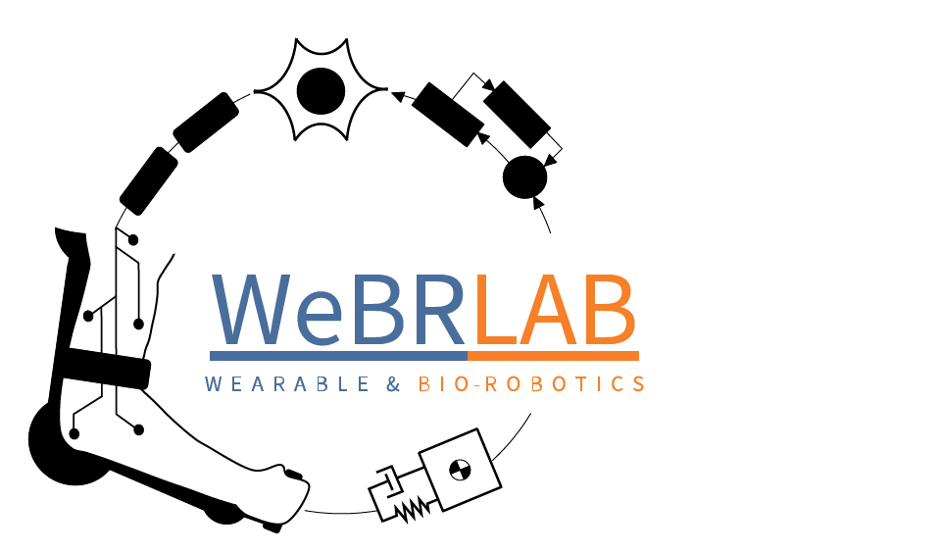
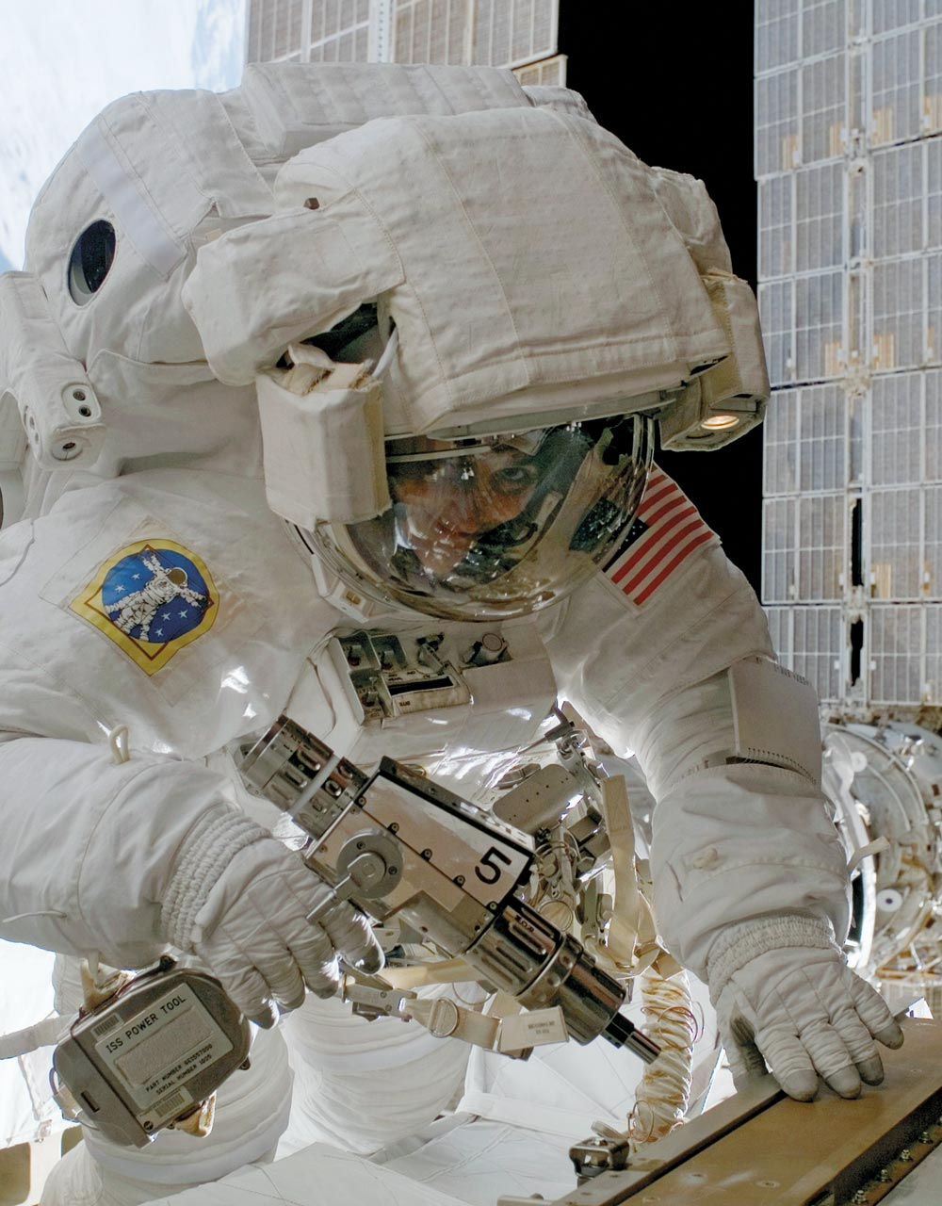
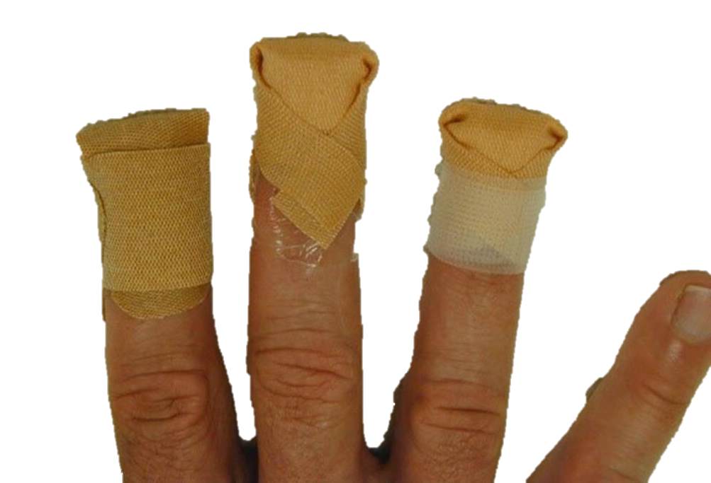
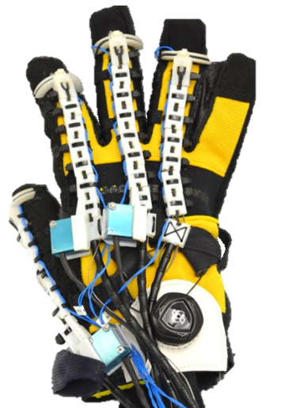
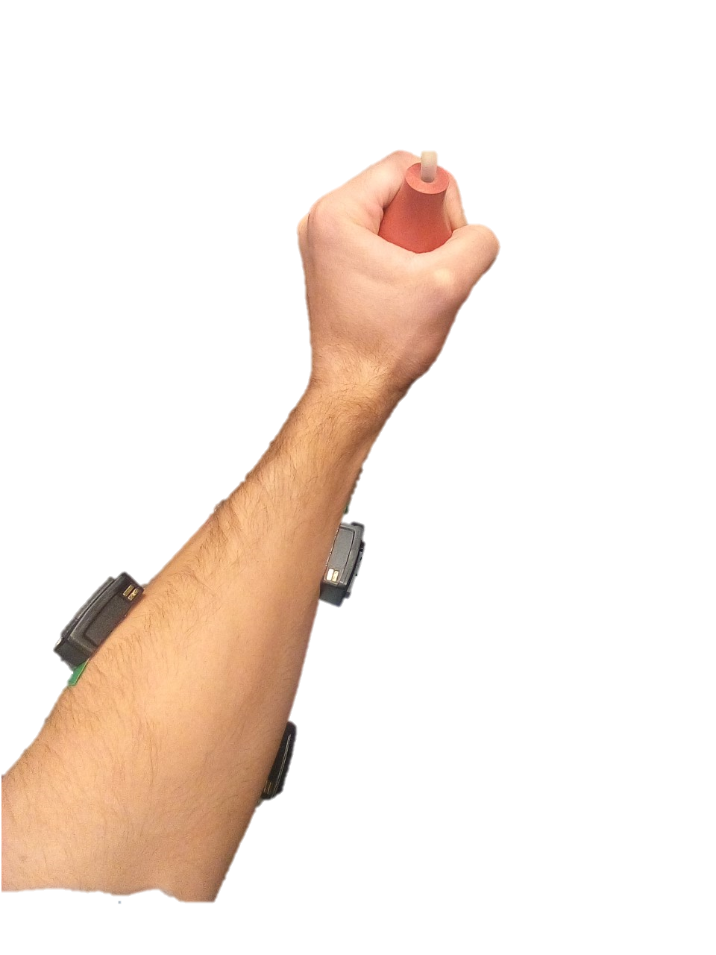
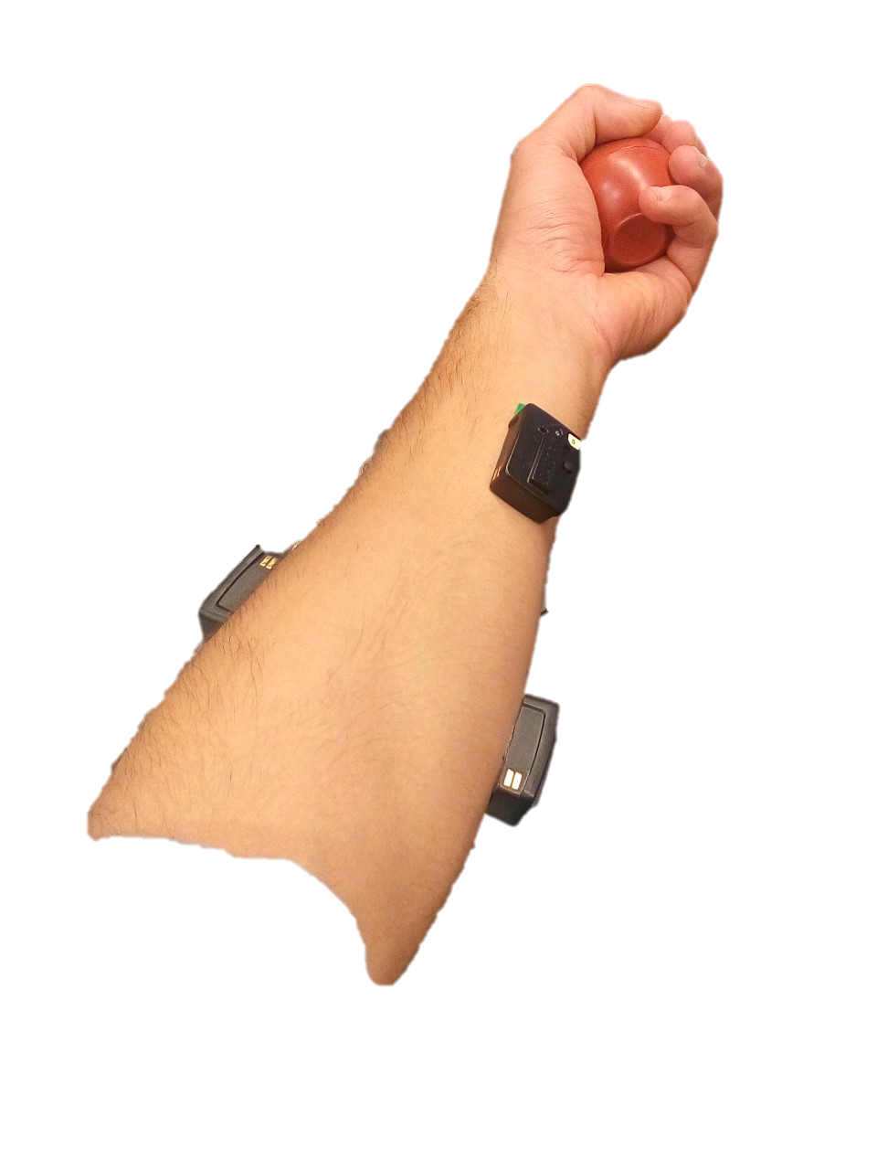
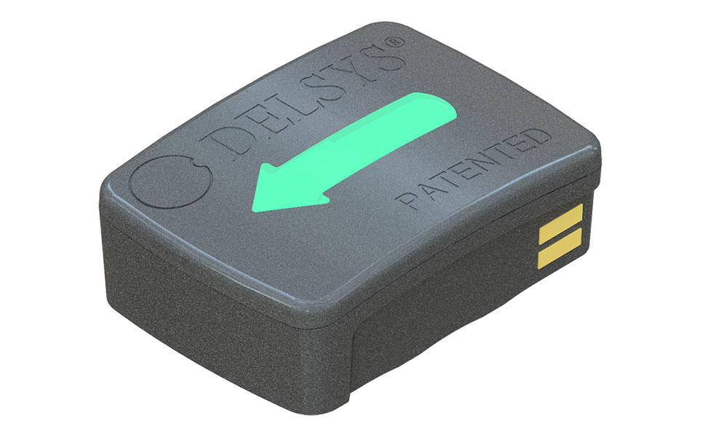
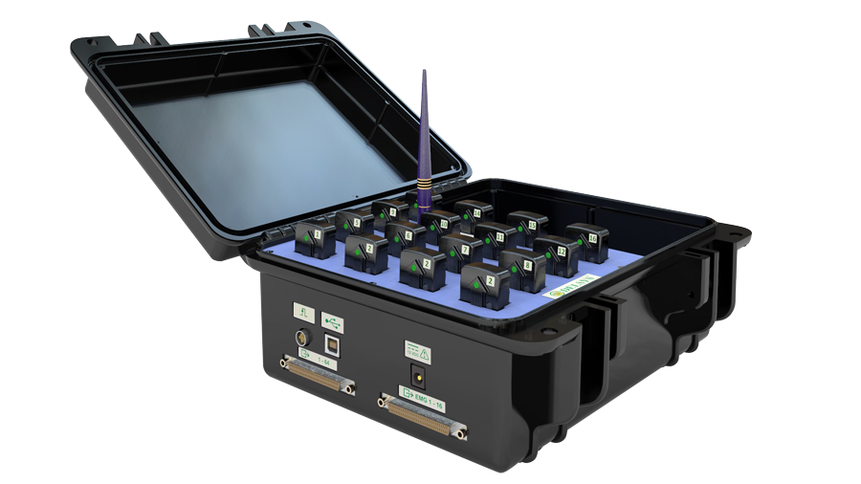
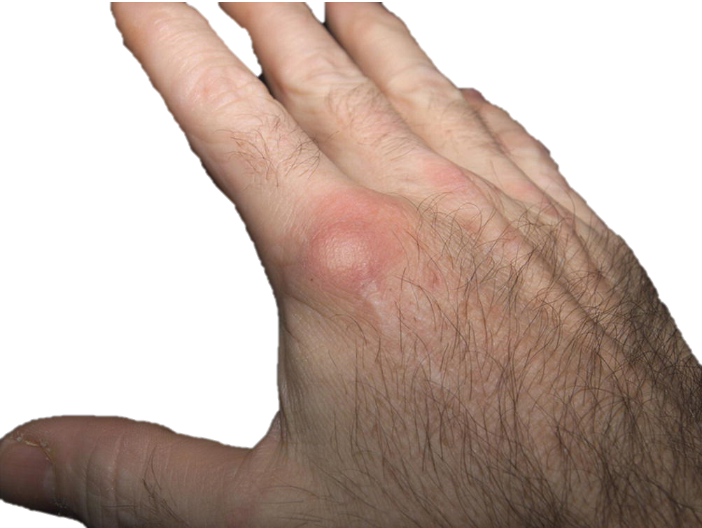
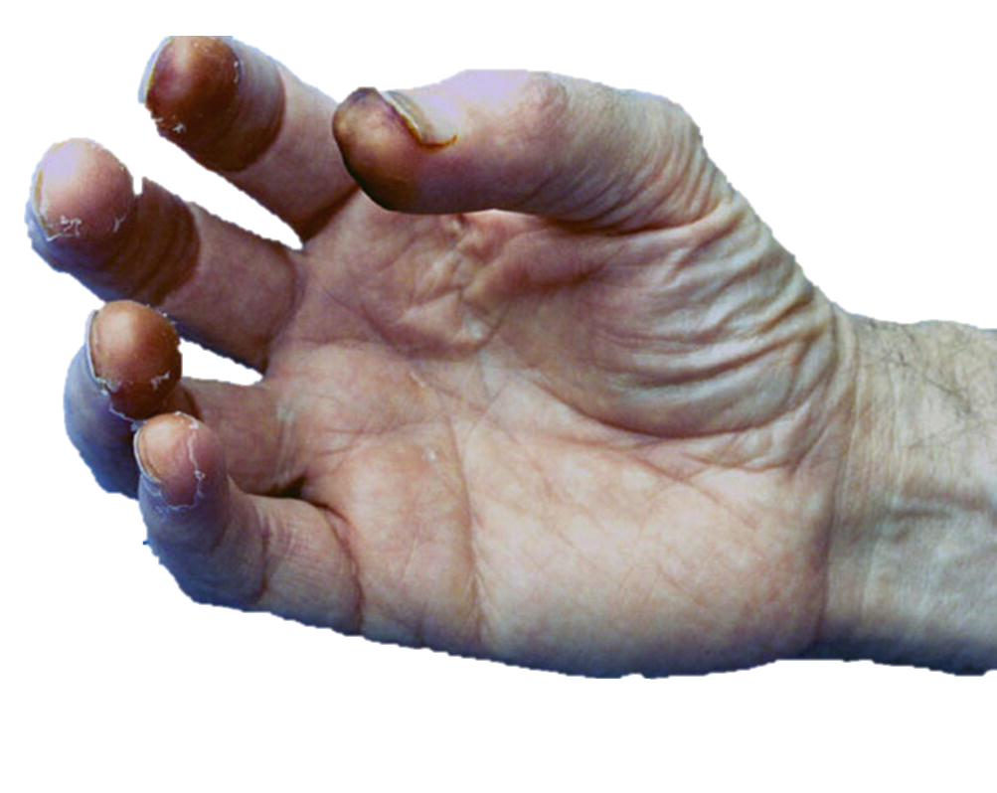
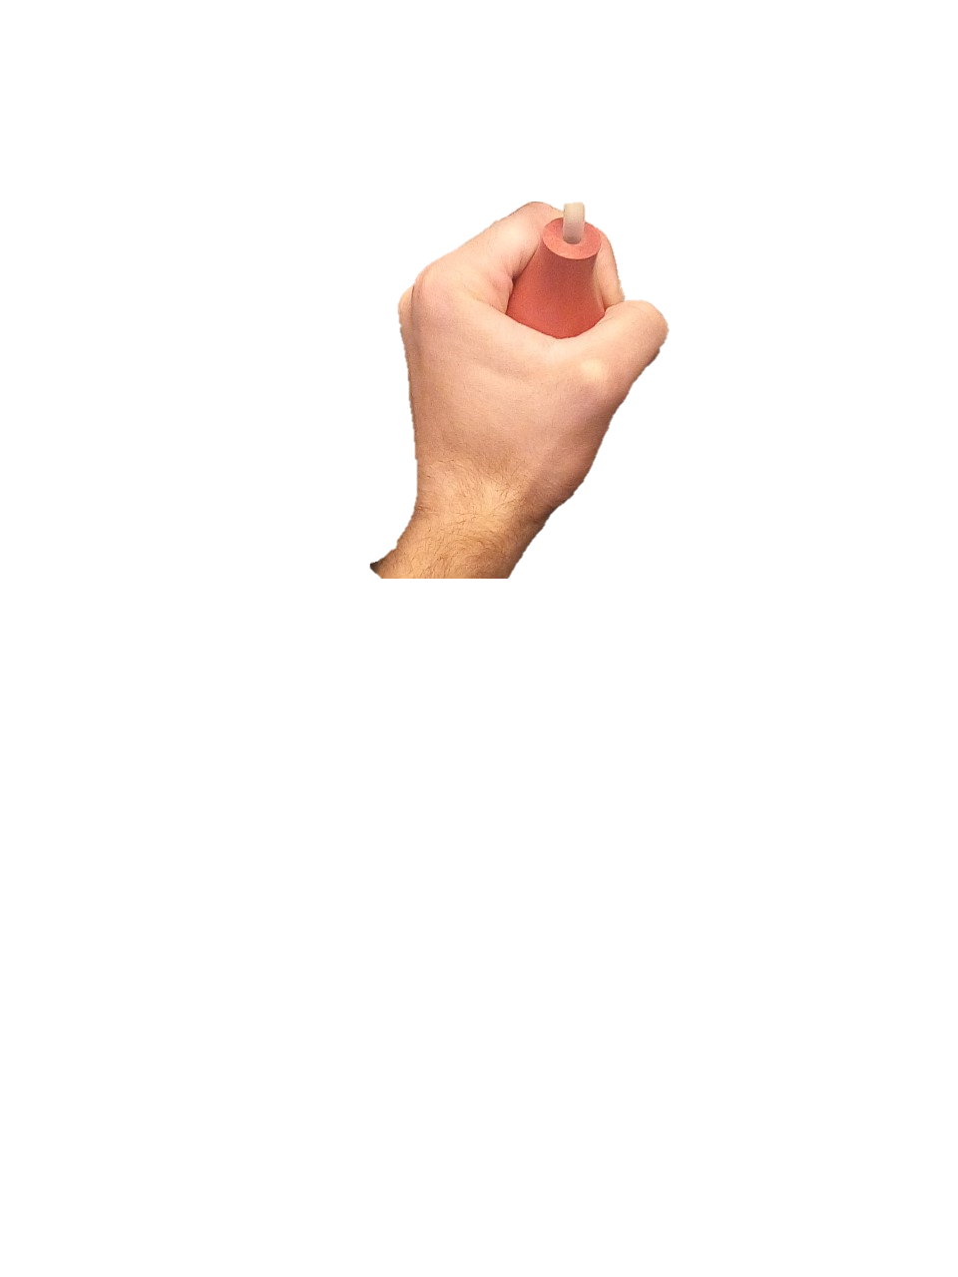
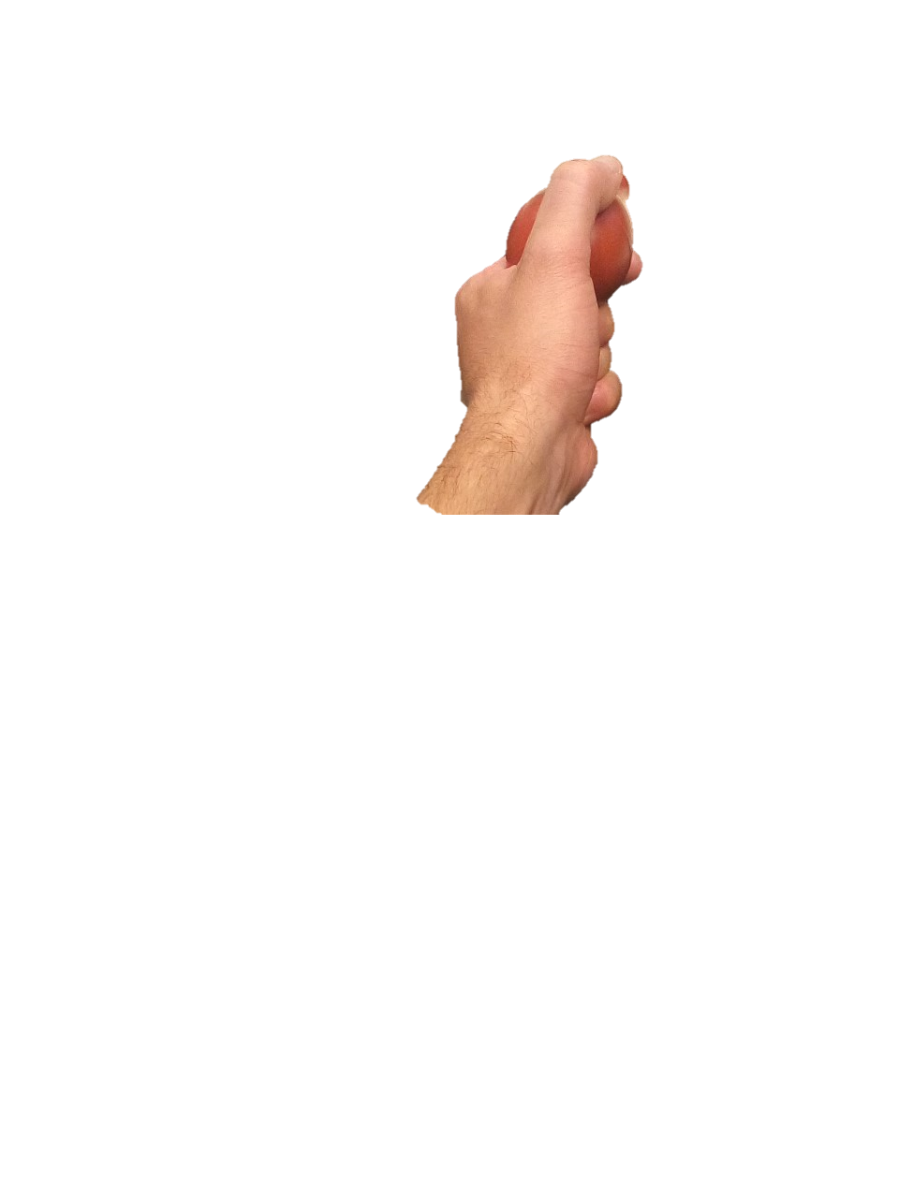
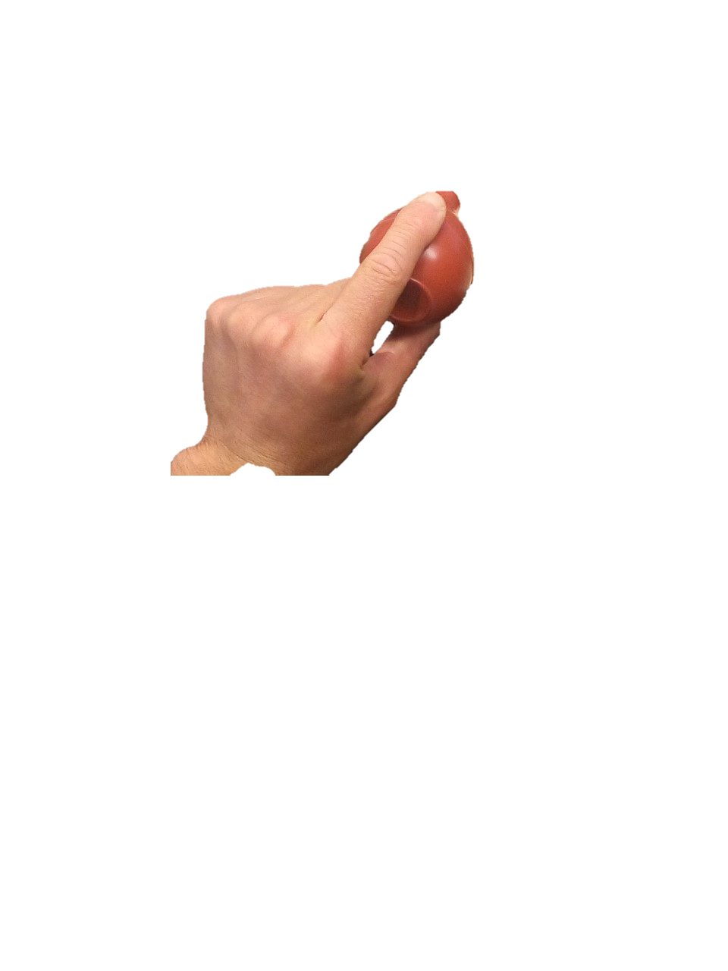
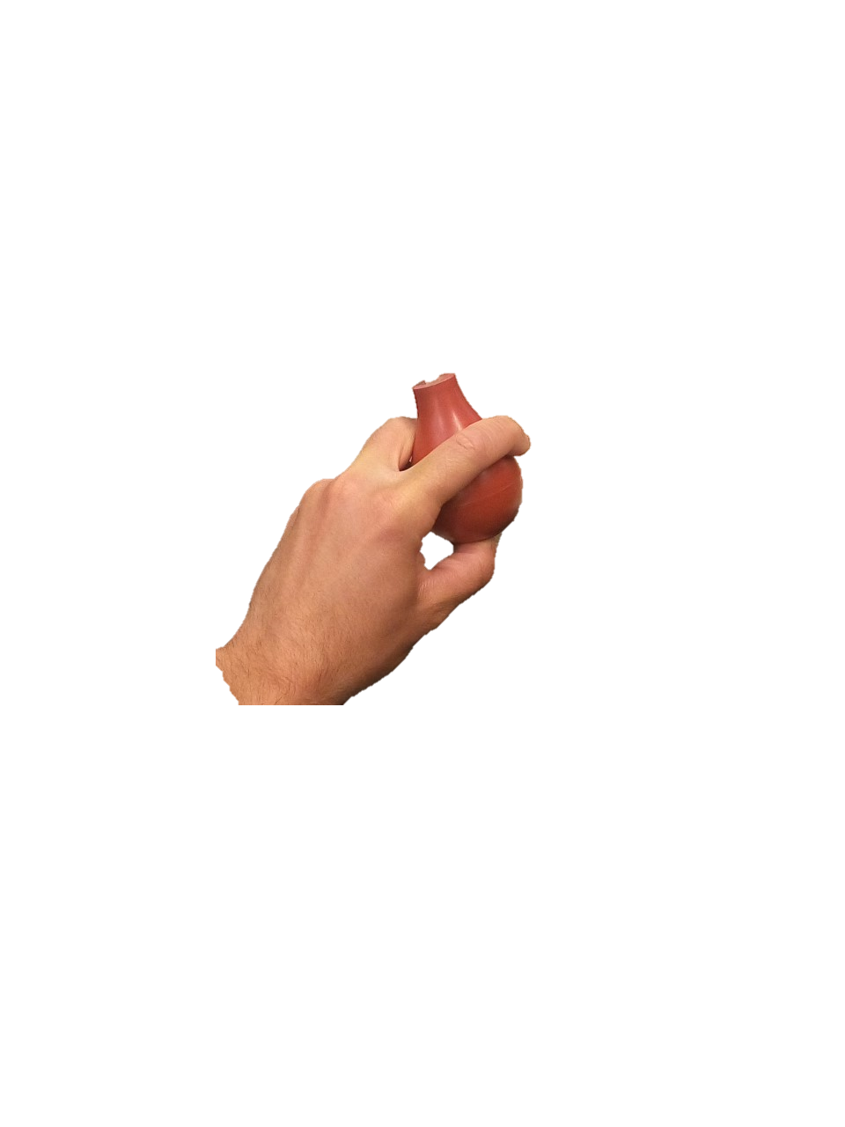
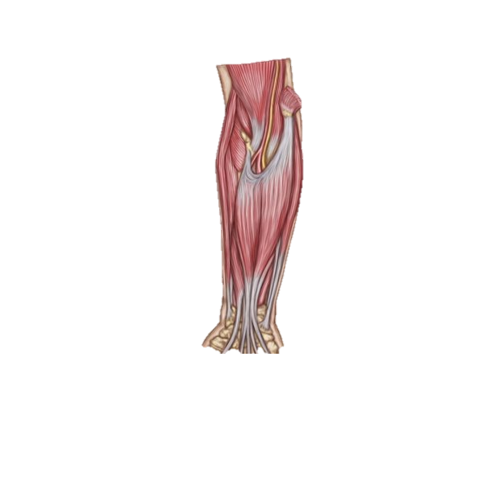
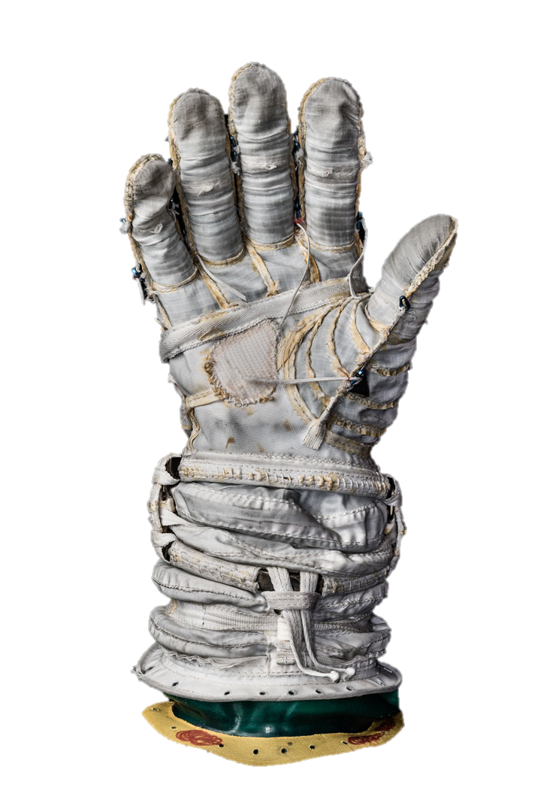
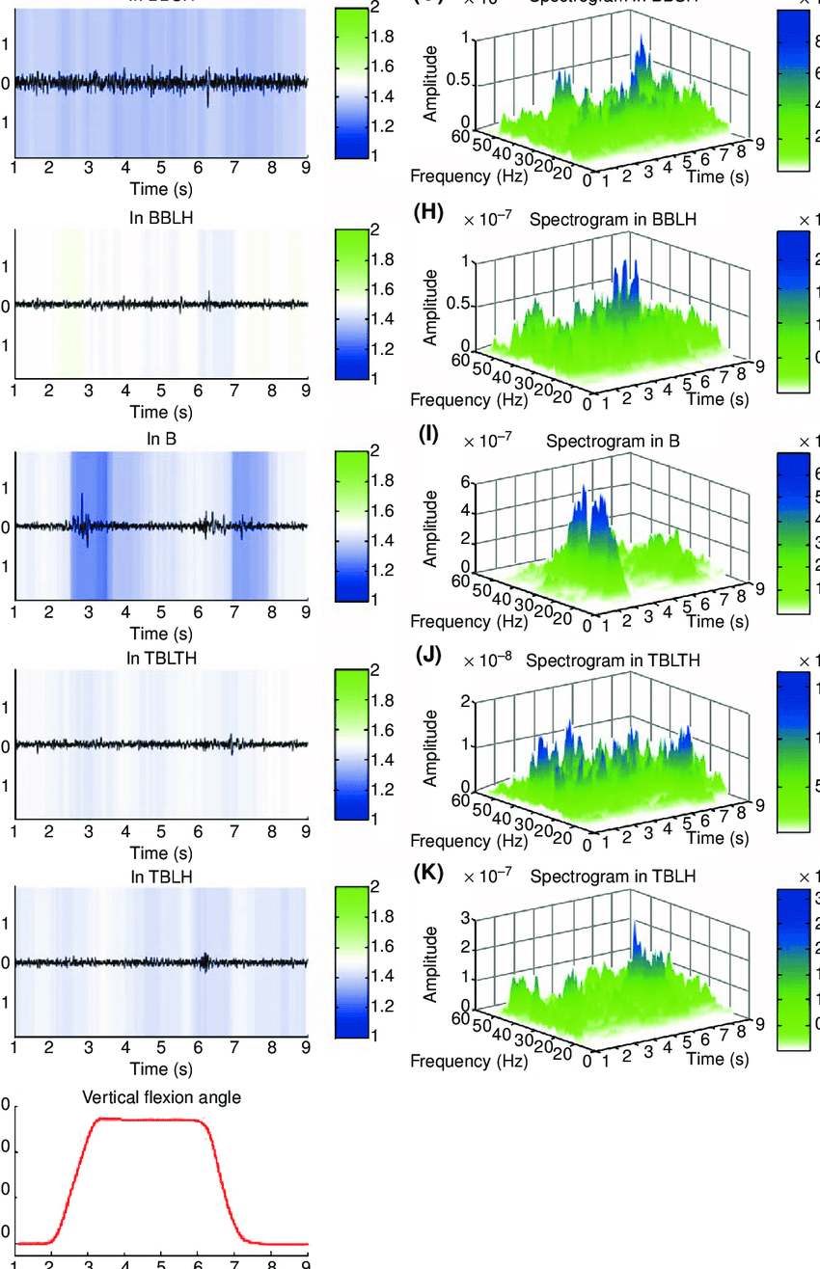
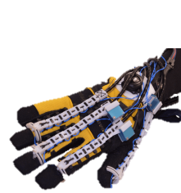
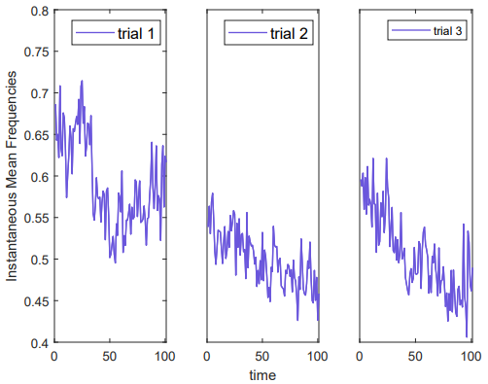
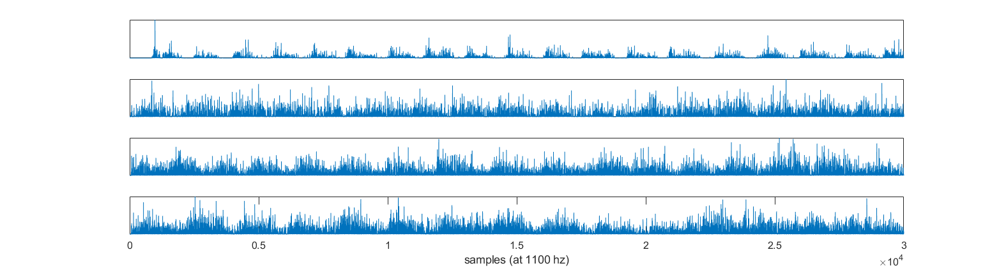
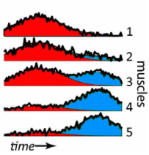
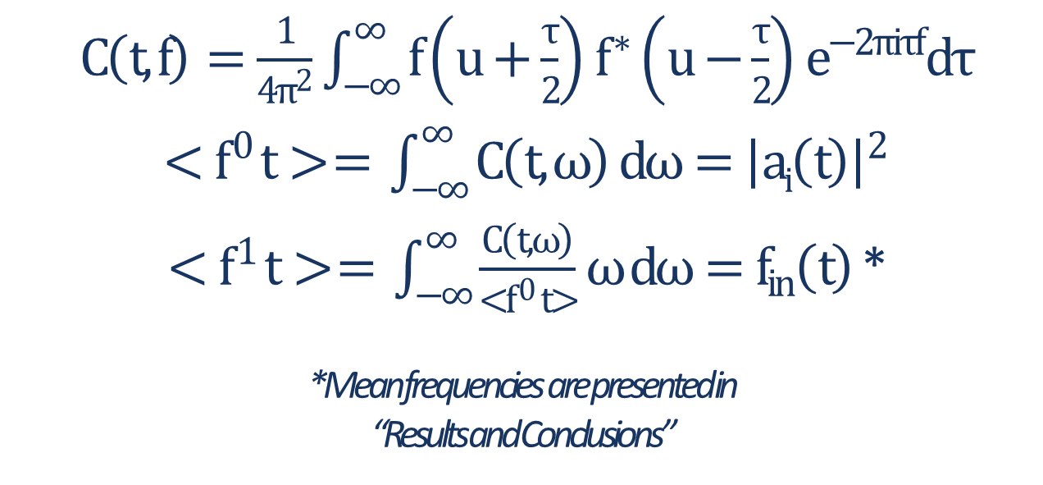
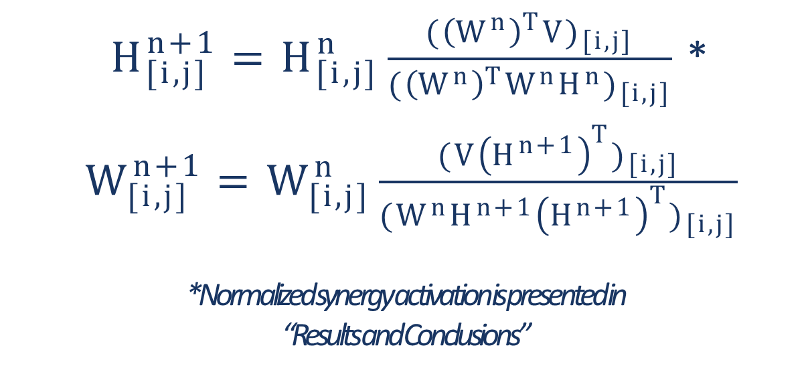
Neuromuscular Classification of Distal Upper Extremity Function for Improved Human-Robot Interaction During Astronaut EVAs
Avinash Baskaran and Chad G. Rose
Department of Mechanical Engineering, Auburn University
Funded by: Alabama Space Grant Consortium
BACKGROUND
METHODS
Hand and wrist Injuries are common in astronaut EVAs, posing significant risks to crew health, mission success and long-term space habitation.
Wearable Robots like the SeptaPose Assistive and Rehabilitative (SPAR) Glove (shown below) can assist in hand grasps to reduce muscular load.
Such devices aren’t sensitive to neuromuscular features like fatigue
Per Institutional Review Board Approved Protocol #22-080 EP 2202, participants were outfitted with sEMG electrodes at finger flexion and extension muscle. A bulb dynamometer recorded force during each of four common EVA hand grasps performed once/second for one minute as well as power grasp held for three one minute trials at the level of 70% of their maximum voluntary feedback with one minute rests in between trials. Visual feedback enabled participants to provide consistent force output
Fatigue Estimation via time-frequency analysis
$C\left(t,f\right)=\frac{1}{4π^{2}}\int_{−∞}^{∞}{f}\left(u+\frac{τ}{2}\right)f^{∗}\left(u−\frac{τ}{2}\right)e^{−2πiτf}dτ$
$<f^{0} t> = \int_{−∞}^{∞}{C\left(t,ω\right) dω={\left|ai\left(t\right)\right|}^{2}}$
$<f^{1} t> = \int_{−∞}^{∞}{\frac{C\left(t,ω\right)}{<f^{0} t>}ω dω=f_{in}\left(t\right)}$ *
*Mean frequencies are presented in
“Results and Conclusions”
Surface electrodes
Intent Prediction via matrix factorization
Fig 5. Participant sensor placement
Wireless interface
$H_{[i,j]}^{n+1}=H_{[i,j]}^{n}\frac{{({\left(W^{n}\right)}^{T}V)}_{[i,j]}}{{({\left(W^{n}\right)}^{T}W^{n}H^{n})}_{[i,j]}}$ *
$W_{[i,j]}^{n+1}=W_{[i,j]}^{n}\frac{{(V{\left(H^{n+1}\right)}^{T})}_{[i,j]}}{{(W^{n}H^{n+1}{\left(H^{n+1}\right)}^{T})}_{[i,j]}}$
*Normalized synergy activation is presented in
“Results and Conclusions”
Fig 1. Astronaut using a high torque power tool during EVA
Fig 2. Common injuries resulting from EVA, reprod. from [14]
Fig 3. SPAR robotic glove for assistance during hand grasps, reprod. from [13]
Power grasp
Lateral pinch
Two finger pinch
Three finger pinch
Fig 6. Common EVA hand grasps [4]
NOVEL APPROACH
RESULTS & CONCLUSIONS
We present a novel paradigm for evaluating neuromuscular features in wrist and hand function during grasping tasks for control of assistive robots
Participant neuromuscular fatigue was readily detected in time-frequency power, assuming quasi-isometricity (Fig. 6).
Matrix decomposition revealed that three neuromuscular synergies accounted for linearly separable variations in gesture trials (fig. 7).
Future steps in this research include constructing an artificial neural network to classify fatigue-related destabilization in muscle synergies with the muscle fatigue as evidenced by time-frequency characteristics (fig. 6) as well as muscle synergy activation (fig. 7).
sEMG Sensing
Machine-Learning Enabled Spectral Classification
(theoretical)
Robot Control tasks
Extensor digitorum
f , K
Flexor digitorum
superficialis
(Fatigue and control parameters)
Power grasp
Lateral pinch
Fig 4. Architecture of proposed research
Two finger pinch
Machine-learning based classification of sEMG spectral features enables estimation of muscle fatigue simultaneously with co-activation patterns.
By improving speed and accuracy in predicting user needs, this approach can improve wearable robot performance in EVA settings.
Three finger pinch
Fig. 6 sEMG instantaneous mean frequencies for one participant holding power grasp over three trials. (fatigue denoted by decreasing trend)
Fig 7. Activation of a set of 3 muscle synergies during each of four hand grasps for one participant, (peak regions reflect multiple hand grasp repetitions)
REFERENCES
[1] S. Boyas and A. Gu evel. Neuromuscular fatigue in healthy muscle: Underlying factors and adaptation mechanisms. Annals of Phys. and Rehab. Med., 2011.
[2] M. L. Gernhardt, et al. Risk of compromised eva performance and crew health due to inadequate eva suit systems. 2009.
[3] K. E. Madden, et. al. The influence of robotic assistance on reducing neuromuscular effort and fatigue during extravehicular activity glove use. 2017.
[4] J. Massion, et. al. strategy and synergy: two levels of equilibrium control during movement. effects of the microgravity.Comptes rendus de l’Academie des sciences. Serie III, Sciences de la vie, 1992.
[5] S. A. Overduin, et. al. Modulation of muscle synergy recruitment in primate grasping. J. of Neuroscience, 2008.
[6] C. G. Rose et. Al. Hybrid rigid-soft hand exoskeleton to assist functional dexterity. IEEE Rbtcs. and Automtn. Letters, 2019.
[7] S. A. Safavynia, G. Torres-Oviedo, and L. Ting. Muscle synergies: Implications for clinical evaluation and rehabilitation of movement. Topics in spinal cord injury rehabilitation, 2011.
[8] Dervay, J., et. al. T.J. (2019). Medical Aspects of Extravehicular Activity. In: Principles of Clinical Medicine for Space Flight. Springer, New York, NY.

Slide 2
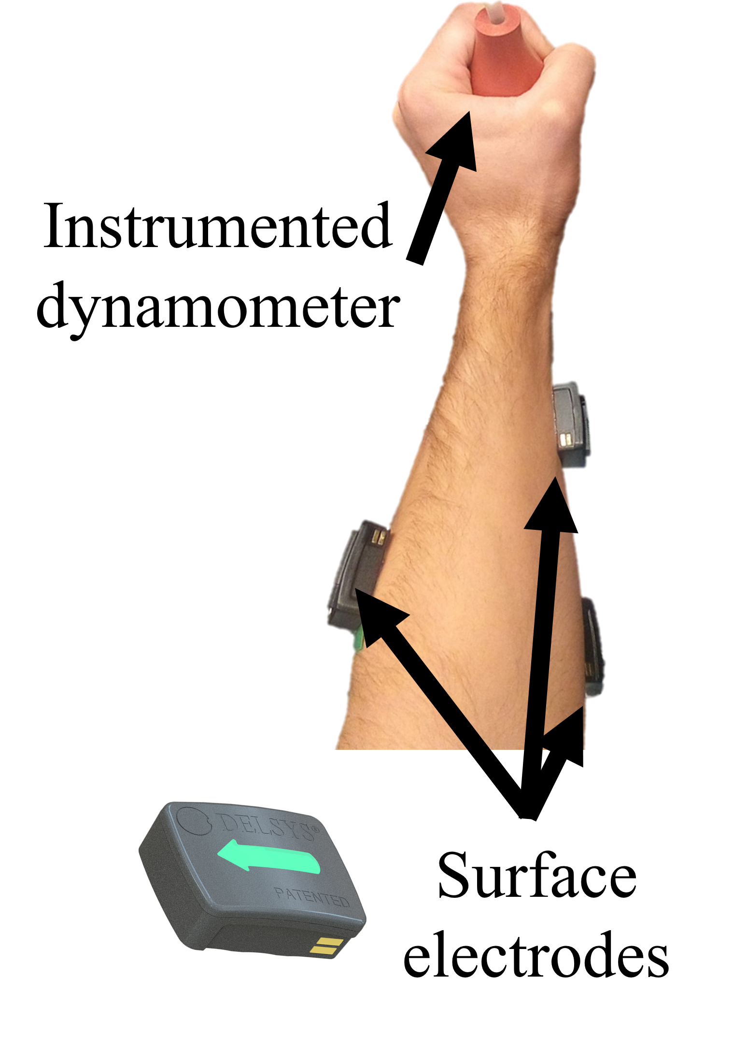
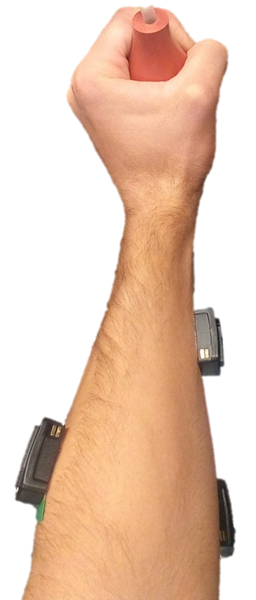
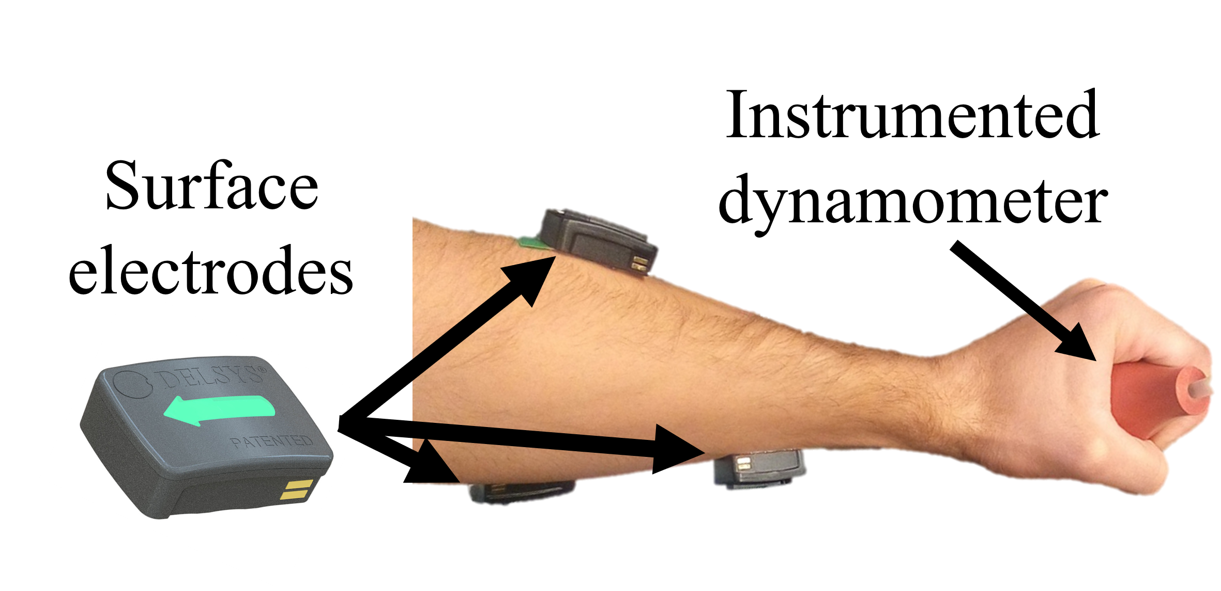
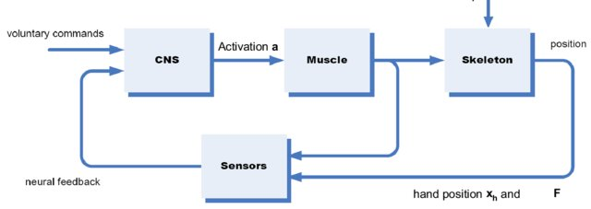
Control
Voluntary Command
Neural Excitation
Control
CNS
Muscle
Wearable Robot
Hand
Grasp
Neuromuscular Fatigue
Proprioception
Voluntary Command
Neural Excitation
Hand
Grasp
CNS
Fatigued Muscles
Wearable robots
Proprioception
Instrumented dynamometer
Surface electrodes
Movement Volition
Neural Excitation
Muscles (Fatigue)
Robotic Exoskeleton
CNS
Movement
Proprioception

Slide 3
Voluntary Command
Neural Excitation
Muscle
Activity
Position
CNS
Muscle
Skeleton
Central Fatigue
Peripheral Fatigue
Proprioception
Wearable Robot
(Obtained via muscle activity classification)
Voluntary Command
Neural Excitation
Control
Position
CNS
Muscle
Skeleton
Muscle
Activity
Neuromuscular Fatigue
Proprioception
Wearable Robot
Neural Excitation
Control
sEMG Sensing
Position
CNS
Muscle
Skeleton
Muscle
Activity
Muscle Synergies
Neuromuscular Fatigue
Fatigue
Volitional Intent
Robot
Control
Proprioception

Slide 4
Voluntary Command
Neural Excitation
Muscle
Activity
Position
CNS
Muscle
Skeleton
Central Fatigue
Peripheral Fatigue
Proprioception
Classification
Wearable Robot
Voluntary Command
Neural Excitation
Control
Position
CNS
Muscle
Skeleton
Muscle
Activity
Central Fatigue
Peripheral Fatigue
Proprioception
(from classification
of muscle activity)
Wearable Robot
Voluntary Command
Neural Excitation
Control
Position
sEMG Sensing
CNS
Muscle
Skeleton
Muscle
Activity
Central Fatigue
Peripheral Fatigue
Muscle Synergies
Fatigue
Volitional Intent
Proprioception
Robot
Control

Slide 5
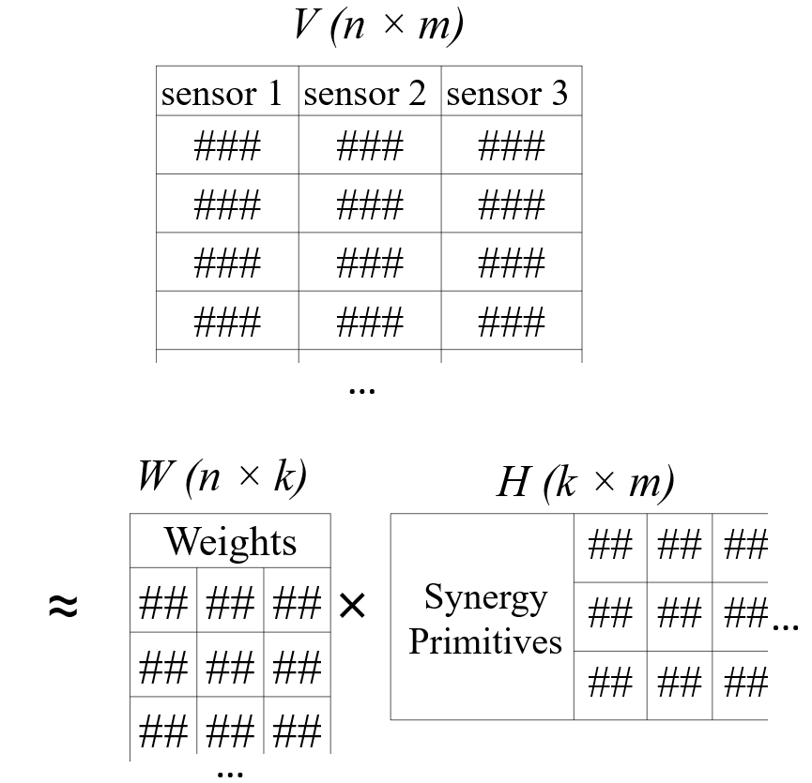
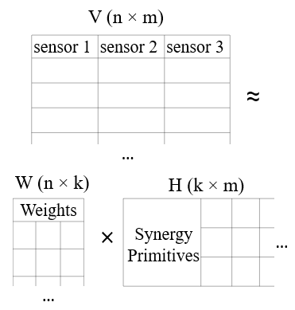
V (n × m)
sensor 1 | sensor 2 | sensor 3
≈
…
W (n × k)
H (k × m)
Weights
…
×
Synergy Primitives
…

Slide 6
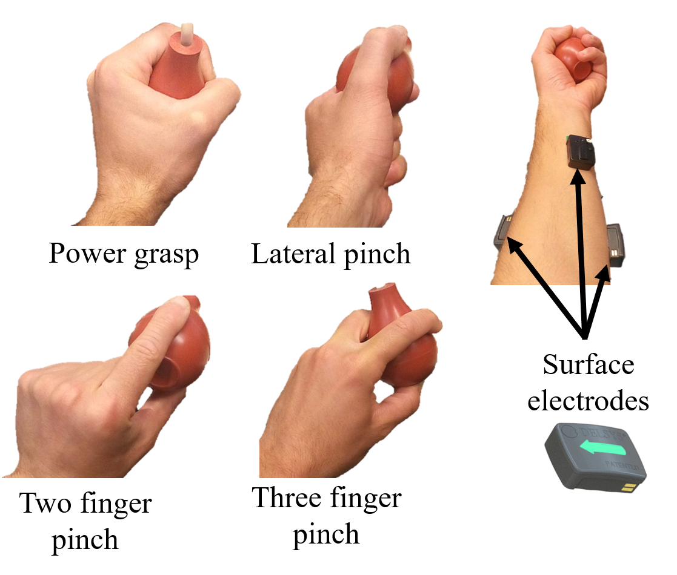
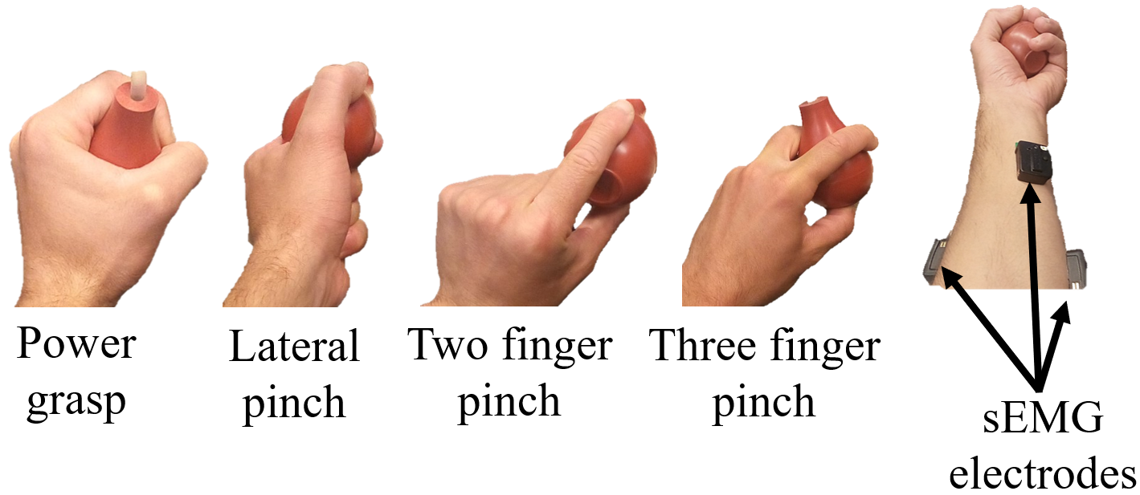
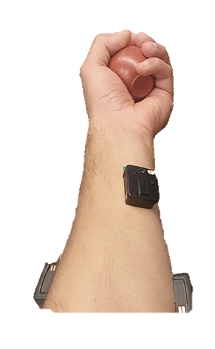
Power grasp
Lateral pinch
Two finger pinch
Three finger pinch
sEMG electrodes

Slide 7


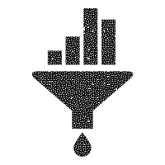



Human-robot interaction plays a key role in healthcare, automation, and military infrastructure, and will continue to enhance human performance in these and other areas.
No standard interface has yet been developed to evaluate and predict muscle fatigue and movement intent.
Probability density of sEMG signal amplitude, a_{i}(t), is analyzed in conjunction with instantaneous frequency, f_{in}(t), to model and predict “neural drive”, a correlate of fatigue that can be modeled
$$<f^{0} t> = \int_{−∞}^{∞}{C\left(t,ω\right) dω={|ai\left(t\right)|}^{2}}$$
$$<f^{1} t> = \int_{−∞}^{∞}{\frac{C(t,ω)}{<f^{0} t>}ω dω=f_{in}(t)}$$
Human
Robot
Fatigue estimation
Joint time-frequency distribution
$$H_{[i,j]}^{n+1}=H_{[i,j]}^{n}\frac{{({\left(W^{n}\right)}^{T}V)}_{[i,j]}}{{({\left(W^{n}\right)}^{T}W^{n}H^{n})}_{[i,j]}}$$
$$W_{[i,j]}^{n+1}=W_{[i,j]}^{n}\frac{{(V{\left(H^{n+1}\right)}^{T})}_{[i,j]}}{{(W^{n}H^{n+1}{\left(H^{n+1}\right)}^{T})}_{[i,j]}}$$
FORCES
Raw sEMG measurements
Filter (10-400 Hz)
Intent estimation
SIGNALS
SIGNALS
Non-negative Matrix Factorization
Decomposition of matrix composed of multiple sEMG signals produces data vectors describing of individual muscle contributions (W_{[i,j]}) to synergistic coactivation patterns (H_{[i,j]})
Sleeve-like wearable sEMG Interface

Slide 8
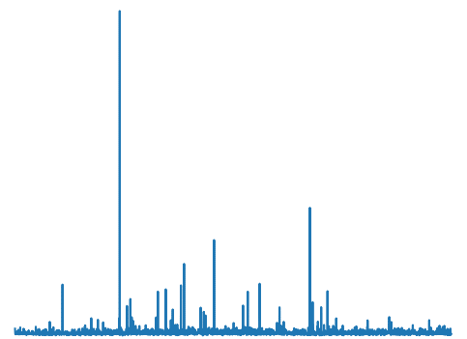
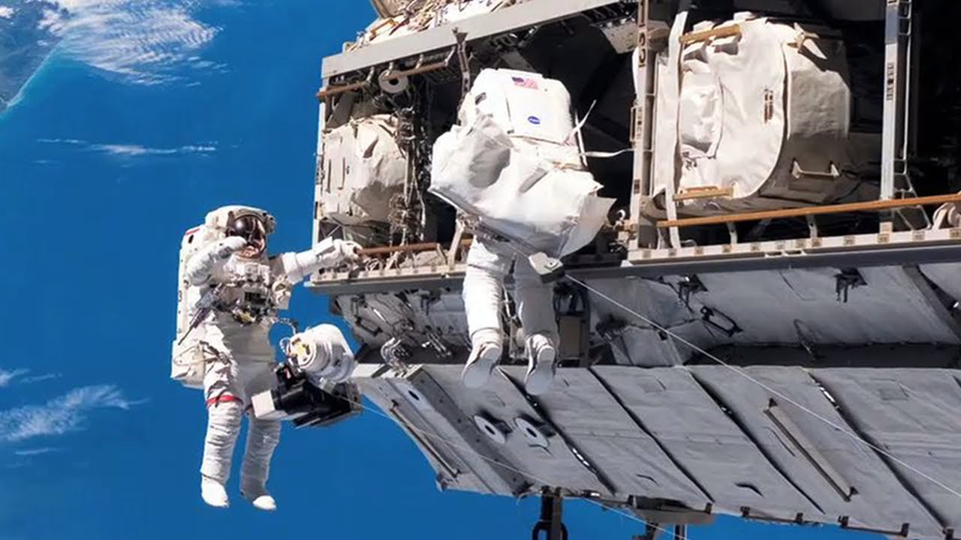
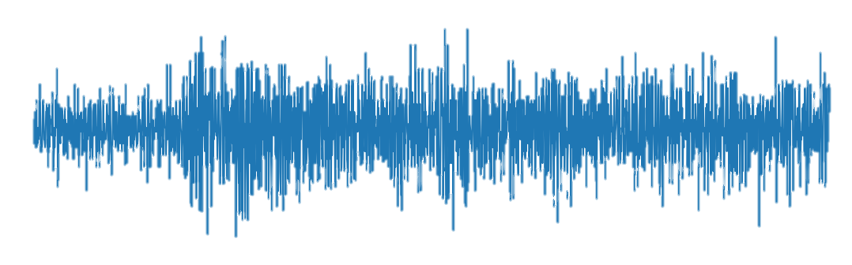
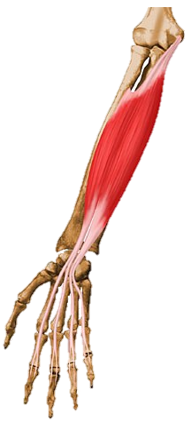

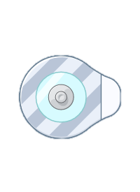
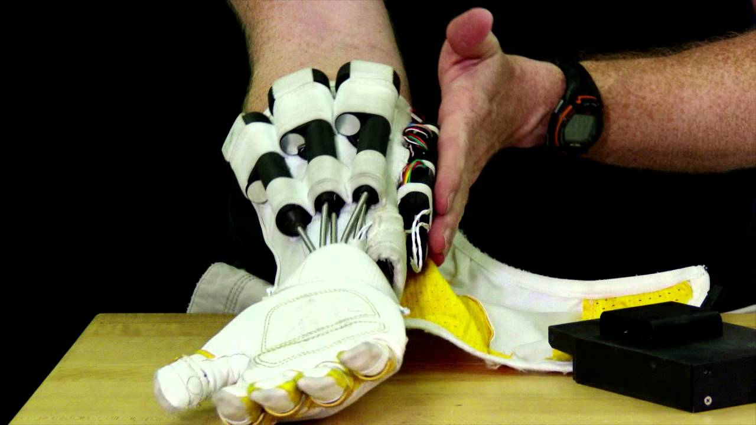
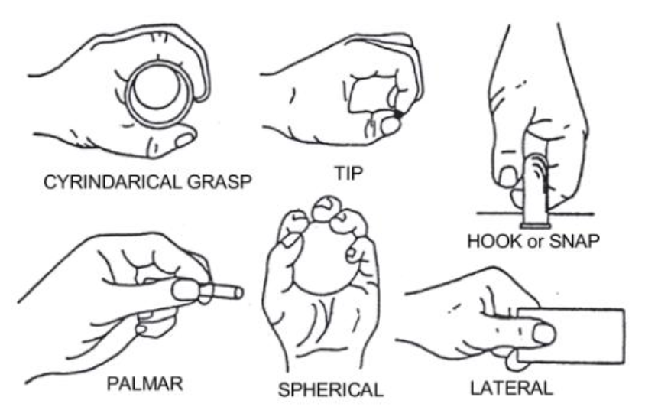

Slide 9
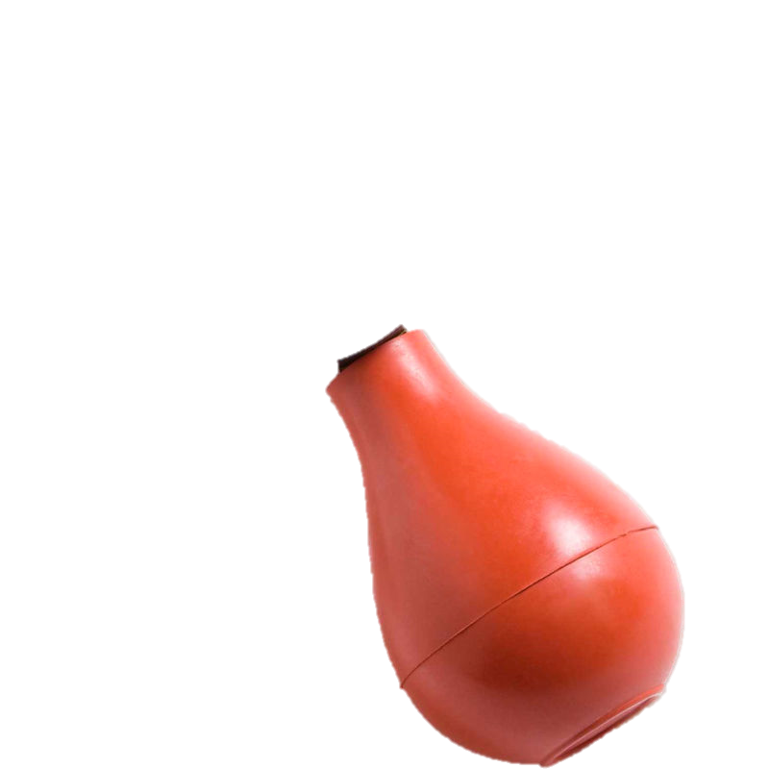
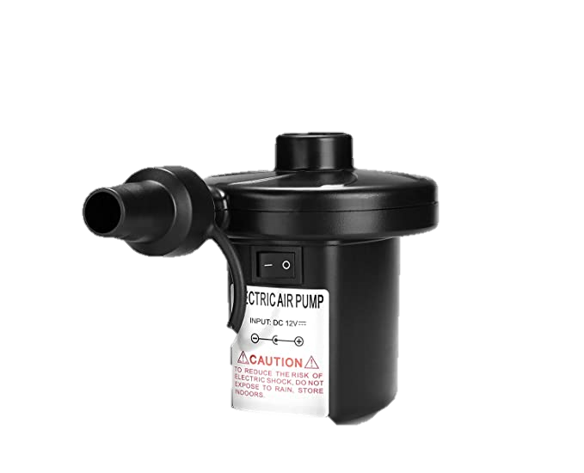
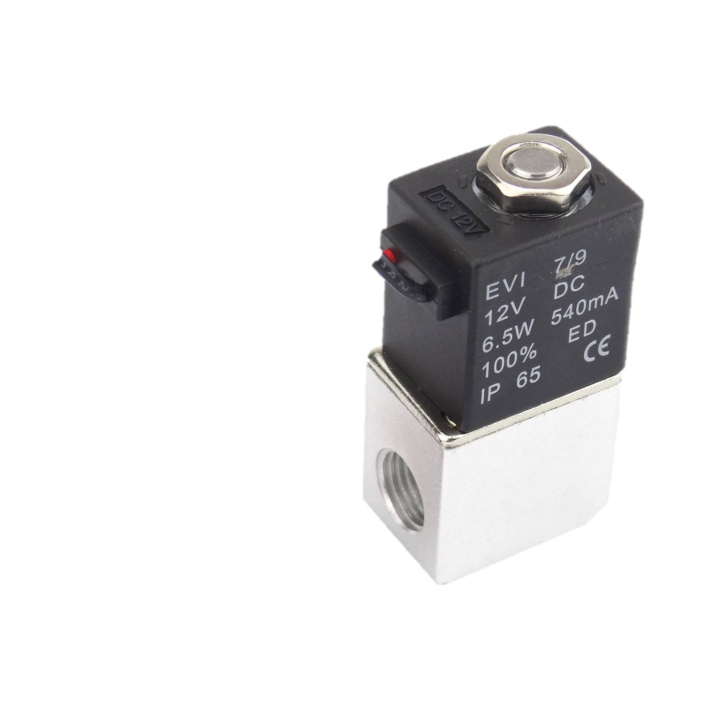
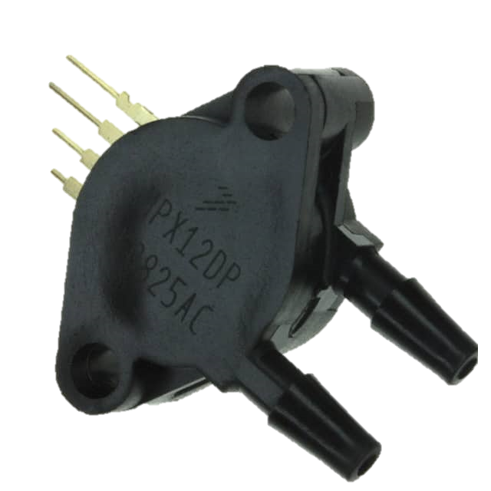
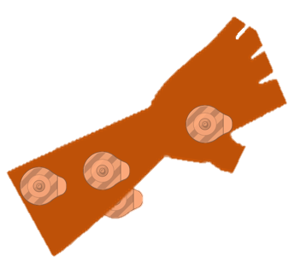
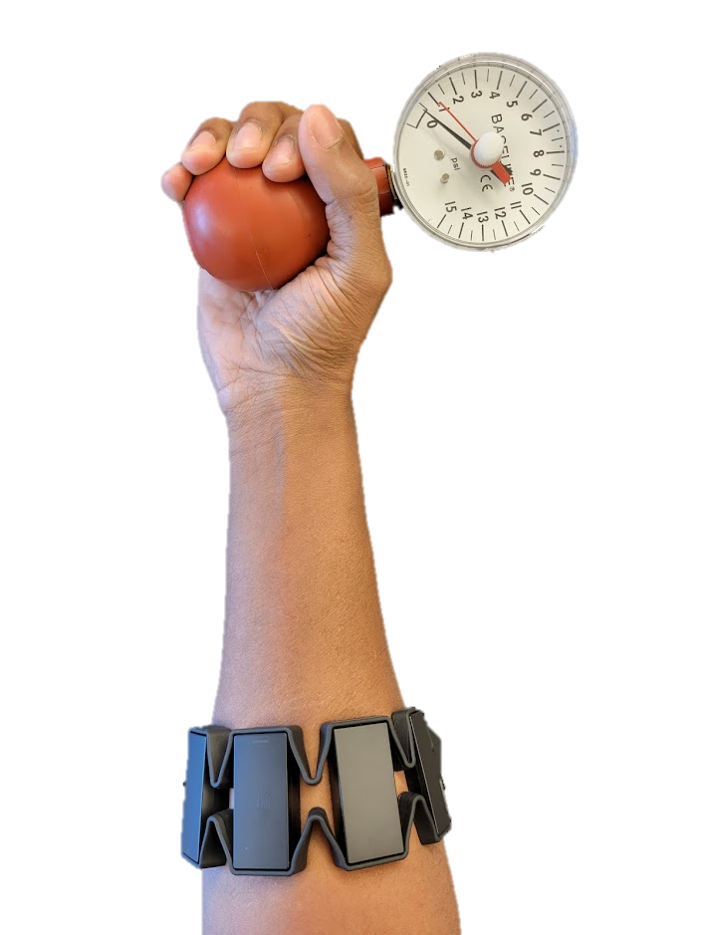
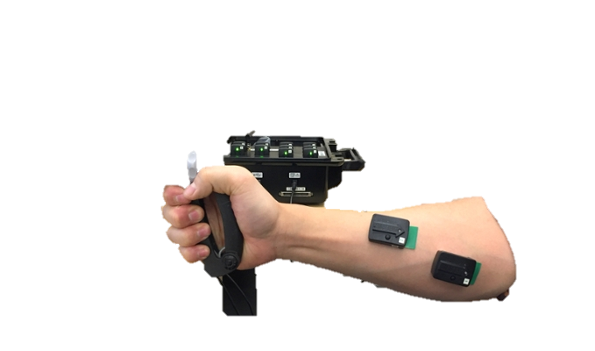
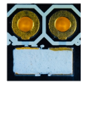

Slide 10
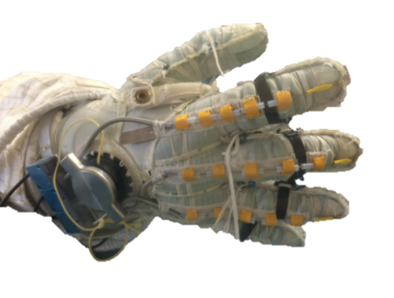
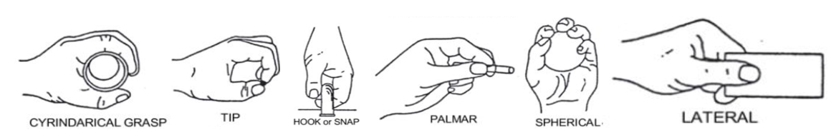

Slide 12







Toward the Future of Manned Space Exploration:
A Novel Wearable Interface for Optimal Human-Robot Collaboration
Avinash Baskaran and Dr. Chad G. Rose
Department of Mechanical Engineering, Auburn University
BACKGROUND
IMPLEMENTATION
Robots can assist astronaut during dangerous or taxing EVAs by providing assistive forces and torques to reduce neuromuscular load.
Sub-optimal interaction between humans and robots due to produces antagonistic forces and torques, diminishing control stability and degrading performance
Processing of the muscle signals includes joint analysis of the probability density of sEMG signal amplitude, a_{i}(t), and instantaneous frequency, f_{in}(t) to model and predict fatigue. Decomposition of sEMG signal matrices will quantify contributions of muscles (W_{[i,j]}) to intended movements models (H_{[i,j]}).
Non-negative Matrix Factorization
Intent estimation
$$H_{[i,j]}^{n+1}=H_{[i,j]}^{n}\frac{{({\left(W^{n}\right)}^{T}V)}_{[i,j]}}{{({\left(W^{n}\right)}^{T}W^{n}H^{n})}_{[i,j]}}$$
$$W_{[i,j]}^{n+1}=W_{[i,j]}^{n}\frac{{(V{\left(H^{n+1}\right)}^{T})}_{[i,j]}}{{(W^{n}H^{n+1}{\left(H^{n+1}\right)}^{T})}_{[i,j]}}$$
Joint time-frequency distribution
Fatigue estimation
$$<f^{0} t> = \int_{−∞}^{∞}{C\left(t,ω\right) dω={|ai\left(t\right)|}^{2}}$$
$$<f^{1} t> = \int_{−∞}^{∞}{\frac{C(t,ω)}{<f^{0} t>}ω dω=f_{in}(t)}$$
(left: Astronaut Sunita Williams using a high torque hand-held tool, right: A robotic hand device for assistance during space walks)
METHODS
A wearable interface embedded with surface electrodes allow for analysis of neuromuscular characteristics including fatigue and intent
CONCLUSIONS
Human
Robot
This work presents a novel human-robot interface which analyzes user fatigue and movement intent using surface electromyography.
reduces garment, It generates and communicates control parameters to wearable robots to minimize their response latency and minimize user fatigue. No other work has presented such an approach, and this work meets a need not only in the literature, but also a felt need in areas such as tele-health and rehabilitation, to Space-suit mounted robotic assistance. Future work includes a comprehensive system usability and efficacy study in a human-participants context.
SIGNALS
FORCES
SIGNALS
Sleeve-like wearable interface
Flexor digitorum superficialis (left), extensor digitorum (middle), flexor pollicis brevis (right)
REFERENCES
[6] K. E. Madden, A. Deshpande, B. J. Peters, J. M. Rogers, E. A. Laske, and E. McBryan. The influence of robotic assistance on reducing neuromuscular effort and fatigue during extravehicular activity glove use. 2017.
[7] J. Massion, V. Gurfinkel, M. Lipshits, A. Obadia, and K. Popov. [strategy and synergy: two levels of equilibrium control during movement. effects of the microgravity].Comptes rendus de l’Academie des sciences. Serie III, Sciences de la vie, 314 2:87–92, 1992.
[8] K. Min, D. Shin, J. Lee, and S. Kakei. Electromyogram refinement using muscle synergy based regulation of uncertain information. Journal of biomechanics, 72:125–133, 2018.
[9] S. A. Overduin, A. d’Avella, J. Roh, and E. Bizzi. Modulation of muscle synergy recruitment in primate grasping. J. of Neuroscience, 28:880 – 892, 2008.
[10] J. Rogers, B. Peters, E. Laske, and E. McBryan. Development and testing of robotically assisted extravehicular activity gloves. 47th International Conference on Environmental Systems, 2017.
[11] C. G. Rose and M. O’Malley. Hybrid rigid-soft hand exoskeleton to assist functional dexterity. IEEE Robotics and Automation Letters,4:73–80, 2019.
[12] S. A. Safavynia, G. Torres-Oviedo, and L. Ting. Muscle synergies: Implications for clinical evaluation and rehabilitation of movement. Topics in spinal cord injury rehabilitation, 17 1:16–24, 2011.
[1] S. Boyas and A. Gu evel. Neuromuscular fatigue in healthy muscle: Underlying factors and adaptation mechanisms. Annals of Phys. and Rehab. Med., 2011.
[2] O. Celik, M. O’Malley, C. Boake, H. Levin, N. Yozbatiran, and T. Reistetter. Normalized movement quality measures for therapeutic robots strongly correlate with clinical motor impairment measures. IEEE Trans. on Neural Systems and Rehab. Engineering, 2010.
[4] M. L. Gernhardt, J. A. Jones, R. A. Scheuring, A. F. Abercromby, J. A. Tuxhorn, and J. R. Norcross. Risk of compromised eva performance and crew health due to inadequate eva suit systems. 2009.
[5] E. Jovanov, I. K. Small, T. D. Rolin, H. Ganegoda, and C. Hill. Long term monitoring of respiration and co2 using flexible printed sensors. 2020.
Funded by: NASA Space Grant College and Fellowship Program

